Slide 1

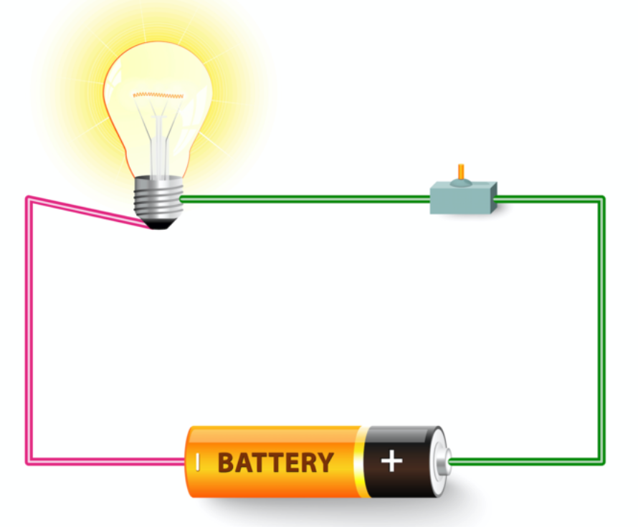
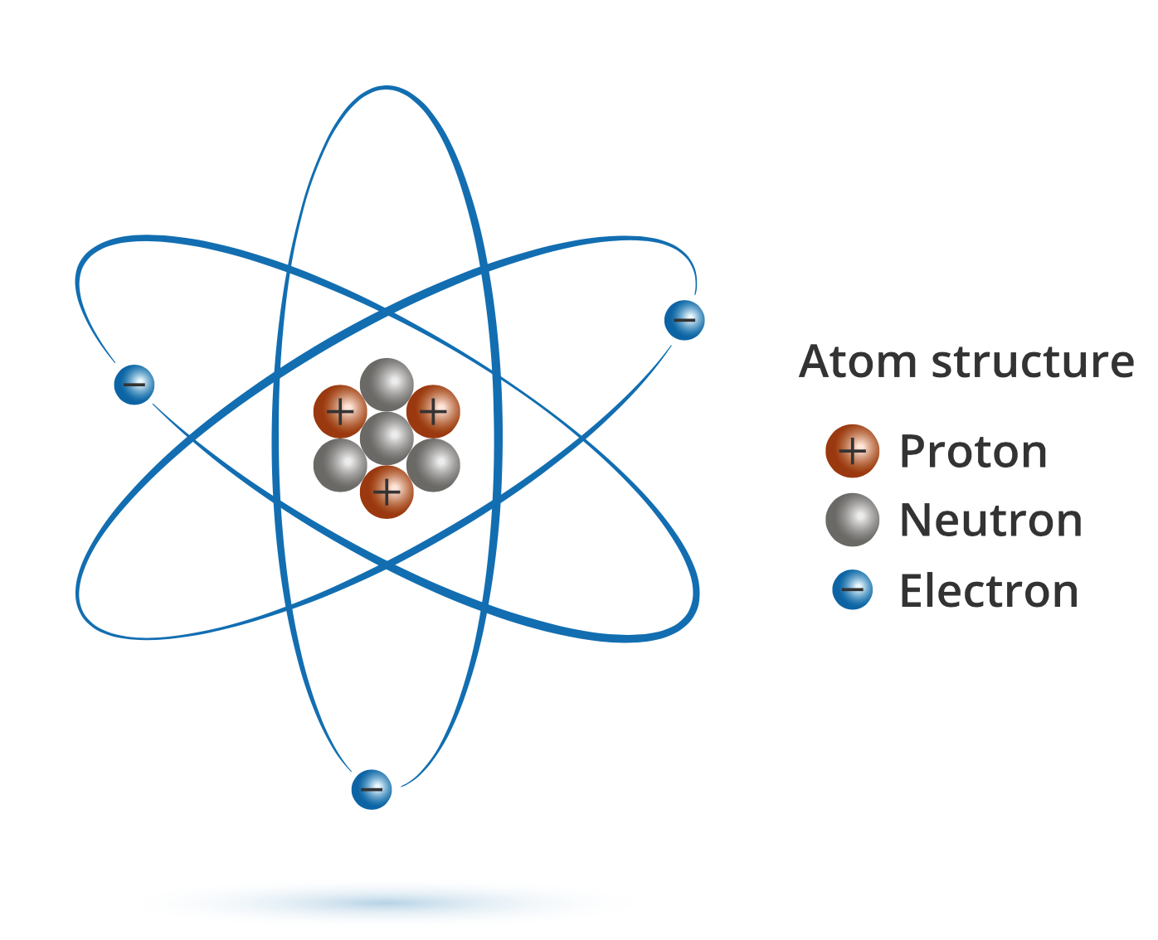

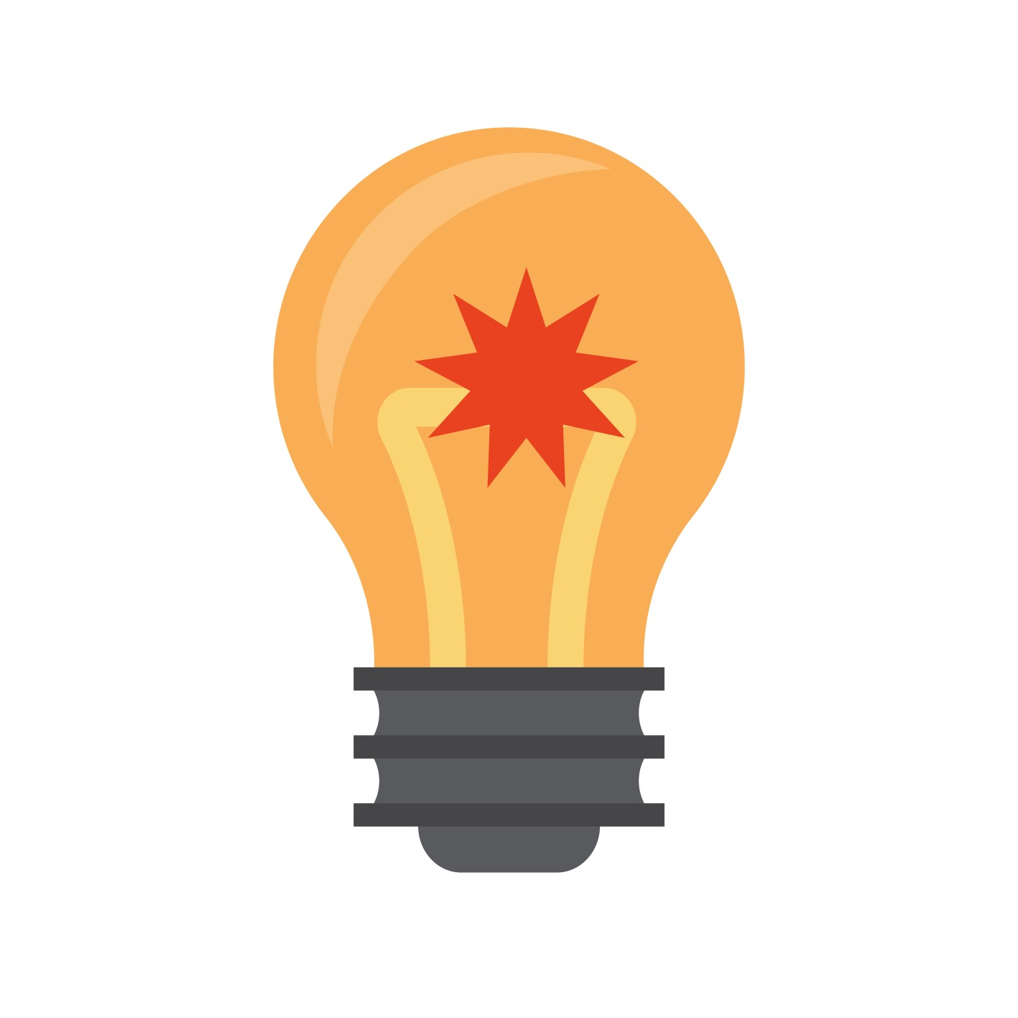
Knowledge Organiser Year 6
Unit: Electricity
When a light is switched on, you are sending a flow of electrons around the circuit.
Metals such as copper, aluminium, zinc and gold are good conductors of electricity.
Light bulbs turn electricity into light due to resistance.
ROCKET WORDS Learn these words and their definitions.
Key Word | Definition
static electricity | Electricity that collects on the surface of an object, which can cause an electric shock.
filament | A thin piece of wire with a high melting point, used in bulbs.
voltage | An electric force which ‘pushes’ the electric current round the circuit.
insulator | A material which doesn’t conduct electricity.
conductor | A material that electricity can flow through easily.
fuse | A safety device on a circuit that can stop current from flowing if it becomes overheated.
component | An individual part in an electronic circuit.
variable resistor | A device which varies the amount of electric current allowed to flow through a circuit.
Electric circuit symbols
FACTOIDS:
Can you find out more?
Q1. How is static electricity created?
A1. Friction on an object creates an electric charge.
Q2. How does a wind-up torch work?
It works through a dynamo which turns mechanical energy to electrical energy through a simple electromagnet.
Q3. How are insulators helpful?
They prevent electric flow so you don’t receive an electric shock!
Lesson Sequence
1
Explain how objects become charged
2
Describe the parts of an electric circuit
3
Explain how voltage affects bulb brightness
4
5
6
Compare electrical conductors and insulators
Build a set of traffic lights
Explain how variable resistors can work like a switch
A simple electric circuit
Unit: Electricity
This unit will help you explore different types of electricity as well as understanding what makes up a circuit. You will learn about this by studying circuit diagrams and by building your own circuits. You will also think about what materials conduct and which insulate, so you know about safety with electricity. It will also help you learn about the importance of saving energy.
Understanding electricity is important for many careers which involve circuitry and installation of electrical devices. It is also helpful for being able to do quick jobs safely and with knowledge.

